Slide 1
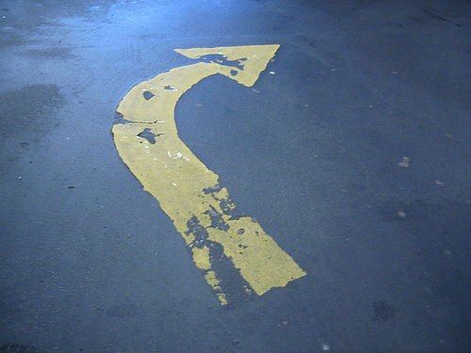
Customer collaboration
http://www.flickr.com/photos/philliecasablanca/2182162819/

Slide 2
Central principles
The customer is part of the team
The customer plays a key role in directing the team

Slide 3
XP collaboration with customers
Customers & Engineers: Collect user stories
Engineers: Identify tasks
Engineers: Estimate effort
Customers: Prioritize stories
Engineers: Plan work
Engineers: Communicate progress
Customers & Engineers: Evaluate results

Slide 4
User story: What it is
Fits easily on a 3x5 note card
Can also be typed into spreadsheet, but harder to review with customers
Name + short description

Slide 5
User story template
“User story name”
As a <type of user>, I want <some goal> so that <some reason>

Slide 6
User story: Examples
View eco-friendliness
As an e-commerce website user, I can click on a product so that I can view its eco-friendliness ratings.
Upload eco-friendliness data
As a trusted 3rd party client, I can upload an XML document specifying eco-friendliness ratings for products so that it is part of the system.
Shopping friendly
As a consumer, I want shopping cart functionality to easily purchase items online.
Users can be roles that other system components play
Notes:
Often times you want to use your pesrona to prompt the user role

Slide 7
User story: Principles
Not written in stone
Revision is acceptable and expected
Fuzzy
Further communication is usually needed
Minimalist
If you add stuff that the customer doesn’t want, then the system will surely cost too much
small enough to be coded and tested in one iteration
Backed up by acceptance tests
Will discuss further in future lecture

Slide 8
User story: How to collect
Gathering user stories
Start from a starting point (some times an epic!)
Let the customer walk through the vision
Customer may have “artifacts” illustrating vision
Chunk the vision into user stories
Ask questions to clarify
Don’t invent stories; let the customer “drive”
Remind the customer that she/he can add more stories later

Slide 9
How detailed are your user stories
Too broad
A team member can view iteration.
Too detailed
A team member can view a table of stories with rank, name, size, package, owner, and status.
A team member can click a red button to expand the table to include detail, which lists all the tasks, with rank, name, estimate, owner, status.
Just Right
A team member can view the iteration's stories and their status with main fields.
A team member can view the current burndown chart on the status page, and can click it for a larger view.
A team member can view or hide the tasks under the stories.
A team member can edit a task from the iteration status page.

Slide 10
Stories for the triangle program
Discuss the stories
What granularity are they…

Slide 11
Identifying tasks
Systematically break down each user story into the pieces of work that will be required
Can often be decomposed using the skills that you already have for decomposing architectures
e.g.: object-, process-, feature-oriented decomposition
Often stated like, “first we’ll implement this change to the system, then this change, then this change… that’s 3 tasks”

Slide 12
Identifying tasks
View eco-friendliness
Set up a database to store product data/ratings
Create web page to show a product’s data
Create web page listing products, so user can click
Upload eco-friendliness data
Set up a database to store product data/ratings
Create a web page for uploading XML document
Write code to read data into database

Slide 13
Effort estimates: What they are
Figure out how much effort each task entails
All estimates should be done in a nebulous “unit” of your own calibration
Typically based on experiences with similar work
Do a spike (an experimental implementation) to estimate difficulty, if needed
Take “bids” from team members for the lowest effort on each task
Sum up task efforts to compute story effort
Tweak this estimate if it seems appropriate

Slide 14
Effort estimates: The nebulous “unit”
A unit is defined in terms of how much work you can get done in the next week’s iteration
To start with, a unit could be defined as how much an average pair of programmers could accomplish in an ideal day.
So an 6-person team has 3 pairs, each of which might be able to get 5 “units” done this week (so the team can do 15 units this week).

Slide 15
Effort estimates: Examples
3u - View eco-friendliness
1u - Set up a database to store product data/ratings
1u - Create web page to show a product’s data
1u - Create web page listing products, so user can click
2.5u - Upload eco-friendliness data
1u - Set up a database to store product data/ratings
.5u - Create a web page for uploading XML document
1u - Write code to read data into database
* = risky… may call for spike!!!

Slide 16
Effort estimates: Examples
3u - View eco-friendliness
1u - Set up a database to store product data/ratings
1u - Create web page to show a product’s data
1u - Create web page listing products, so user can click
2.5u?- Upload eco-friendliness data
1u - Set up a database to store product data/ratings
.5u?- Create a web page for uploading XML document *
1u - Write code to read data into database
* = Not sure? Sounds risky?… may call for spike!!!

Slide 17
Be empirical
When in doubt, do a spike
What it is: A small program that explores and tests possible solutions
How to do it:
Identify one key thing that you need to discover
Write a little code to test an idea
Tweak the code until you get the info you need
Throw the code away, keep the knowledge

Slide 18
Be conservative
Conservative estimates are based on each user story individually
i.e.: don’t assume a certain ordering of the waiting stories
Yes, you’ll end up over estimating effort

Slide 19
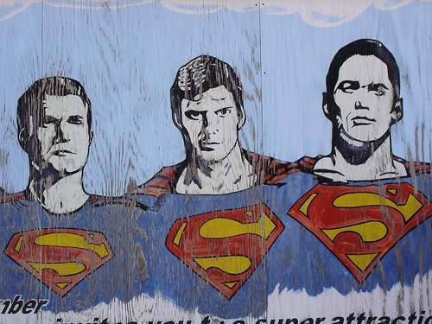
Be realistic
It is expected that you will work at a sustainable pace.
No heroes, no all-nighters, no super-human feats
Either you get the code done like a human being, or you don’t get it done
http://www.flickr.com/photos/aka_kath/185679814/sizes/m/in/photostream/

Slide 20
Be honest
Engineers give honest estimates that customers can trust.
Engineers make estimates.
Customers make priorities.
XP Saying: “He who does the work sets the estimate.”

Slide 21
Triangle application
As a pair pick the user stories (for the team)
As individuals
break down 2 (same) user stories to tasks
estimate effort for each task/story
As pairs
Discuss the effort estimates
Were you different? How different

Slide 22
Customers prioritize stories
Now that each story has an associated effort, customer gets to choose which stories will be implemented in the next iteration
E.g.: “Stories A, B and C each will take 10 units; stories D and E each will take 5 units; we can do 20 units this week. My dear customer, what stories should we do?”
It’s like writing a shopping list using a certain budget.

Slide 23
Customers prioritize stories
The engineers get to make technical decisions
The customer gets to make business decisions
Don’t “steer” the customer
Do help the customer to understand consequences of choices
Do not try to persuade the customer that stories should be implemented in a certain order

Slide 24
Planning work
Once the customer has chosen stories, teammates get organized.
Get together and decide who will perform each story’s tasks.
Figure out how to work in pairs for these tasks
This is a tentative assignment and will probably evolve
Mix it up: don’t work in the same pair all the time!
Plan how to avoid stepping on each other’s toes.
Finalize your development environment

Slide 25
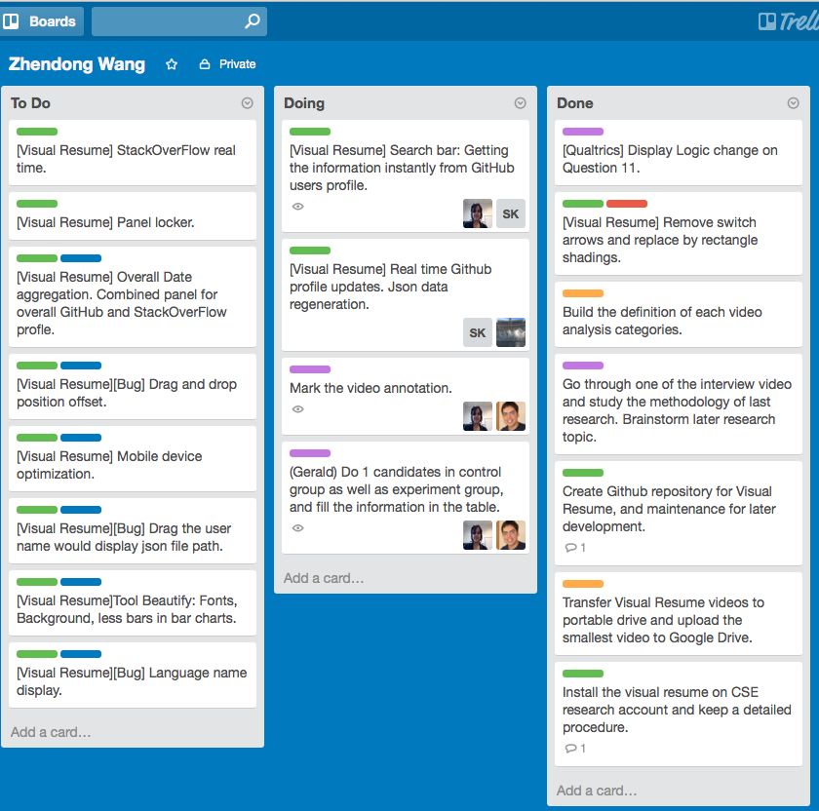
Trello

Slide 26
Planning work: Examples
Monday: Jim & Peg
1u - Set up a database to store product data/ratings
Load with two sets of test data
Tuesday-Wednesday: Jim & Joe
1u - Create web page to show a product’s data
1u - Create web page listing products, so user can click
Use one set of test data for unit tests
Tuesday-Wednesday: Peg & Phil
.5u - Create a web page for uploading XML document
1u - Write code to read data into database
Use the other set of test data for unit tests

Slide 27
Communicating progress
Track effort by using estimates (best from past iteration)
Track velocity… how many units are you doing per week?
Refine your understanding of your capabilities
All news (good or bad) should be communicated early
Keep the customer informed of good news & bad.
Keep your team informed, too!!!
Release dates don’t slip; functionality slips.
It might be necessary to delay user stories
Customer prefers 3 fully-working user stories rather than 6 half-working stories!

Slide 28
Communicating progress: Examples
Monday: Jim & Peg
1u - Set up a database to store product data/ratings
Monday at noon: “DONE! Everybody should log in and try out the database”
Tuesday-Wednesday: Jim & Joe
1u - Create web page to show a product’s data
1u - Create web page listing products, so user can click
Wednesday: “Finished story and completed integration test”
Tuesday-Wednesday: Peg & Phil
.5u - Create a web page for uploading XML document
1u - Write code to read data into database
Wednesday: “Not done yet… probably tomorrow @ noon”

Slide 29
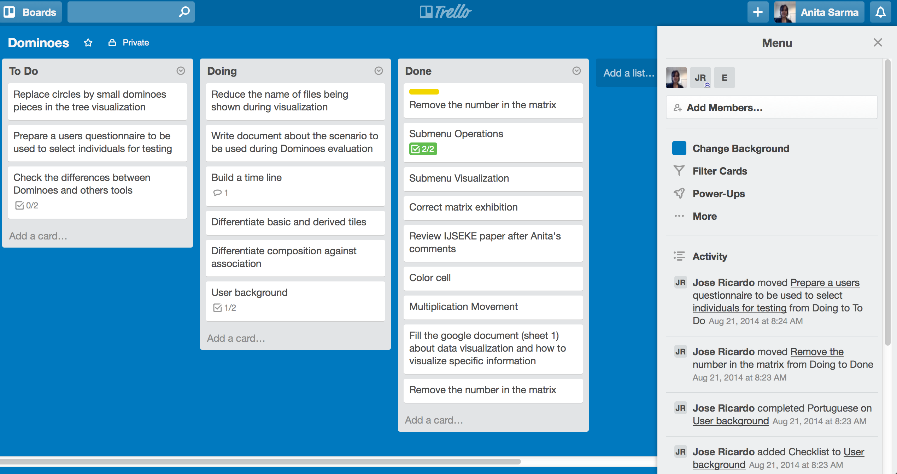
Trello

Slide 30
Evaluating results: continual testing
Unit tests
Each pair is responsible for writing automated tests, then writing code to satisfy the tests
Integration tests
Several times during the week, check if the pieces work together properly
Acceptance tests
Customer tests the system upon receiving it (essentially automated use cases)

Slide 31
Evaluating results: After the iteration
Debriefing (without customer present)
Discuss what went well, what didn’t
No ad hominem attacks or raw emotion, just respectful and honest feedback
Assess your productivity
Refine estimates of remaining tasks/user stories
Evaluation of release
Customer runs acceptance tests
Discuss what works, what to do next

Slide 32
Evaluating results: examples
At the debriefing, discuss…
Setting up database was faster than expected!!
Jim was really good at setting up database!
Get Jim to teach this during future pairings!!
Peg & Phil struggled with file upload
Maybe pair them differently for a while?
Do we need a different file upload component?
What files will we be delivering in this release?
Any configuration instructions?

Slide 33
Evaluating results: examples
Presentation of the release
Customer tries out the acceptance tests
Well, the user interface isn’t as expected
Sketch some changes on paper
Staple to the user story
Here are five other ideas for extending the vision
Write them up as a user stories
Then launch into the next iteration (estimating)

Slide 34
What’s next for you – HW5
Meet as an entire team with the customer to develop 10-20 user stories
As a team, break the user stories into tasks. Decide which tasks will be easier or harder to implement, and which ones should logically be completed first
Meet with the customer to divide user stories into three groups: the stories that you will implement by the end of Week 8, the stories that you will implement by the end of Week 10, and the stories that you will probably not have time to implement. Plan how your team will tackle the tasks that are due by the end of Week 8
Set up your development environment; you need to use a version control system. You may use GitHub or BitBucket for use as a free git server if you want (it is not mandatory). Add your team TA to the group/organization. You may use Trello to manage your stories and track progress.

